Slide 1
Object Detection Using
Depth and Color Images
Team: CrazyOnes

Slide 2
Problem
As use of depth sensors has increased widely due to the application in various gaming consoles and autonomous car, it is important to understand the use of depth data.
Depth data helps in getting perspective about relative distances between objects present in the image along with adding one extra dimension to the available information.
We are analysing how this depth data can be used for increasing the accuracy of existing object detection models using machine and deep learning.

Slide 3
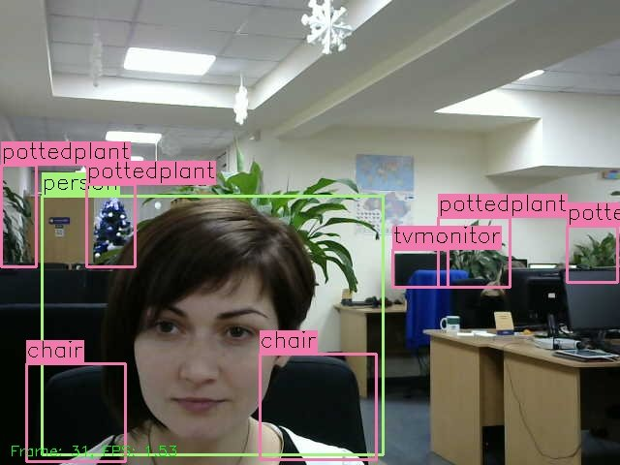
Existing Object Detection
Mask R-CNN - Detection with Segmentation
YOLOv2 - Faster and Stronger
MobileNet by Google - Lightweight
Although this models provide state-of-the-art accuracy with speed on real-world scenarios:
Accuracy for pre-trained objects is hard to achieve on custom objects.
No use of depth sensors information
Object View matters a lot...

Slide 4
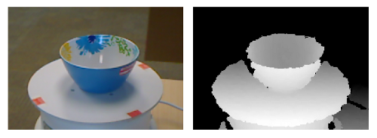
Approach 1
We have 2 images for 1 particular scene, let’s train them separately. Then combine the models to achieve a better accuracy in detection.
Used YOLO-v3 for default object detection for both the images but...

Slide 5
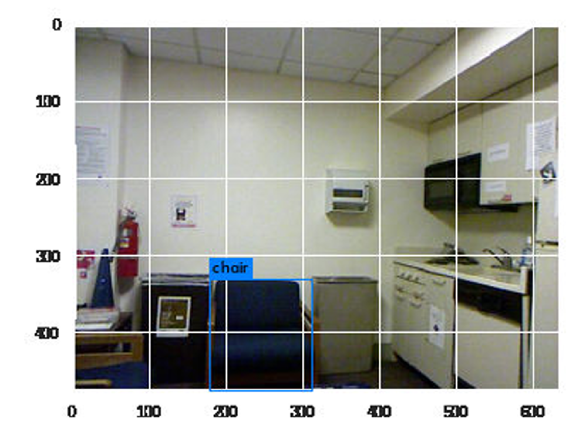
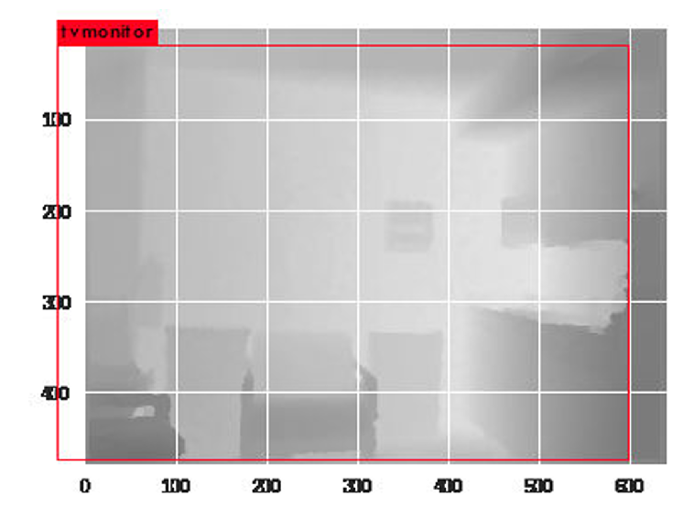
Approach 1
This approach fails miserably as YOLO fails to extract any information from the depth image of data. Faster R-CNN also fails on this depth images taken from the NYU Depth Dataset V2.

Slide 6
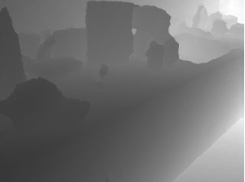
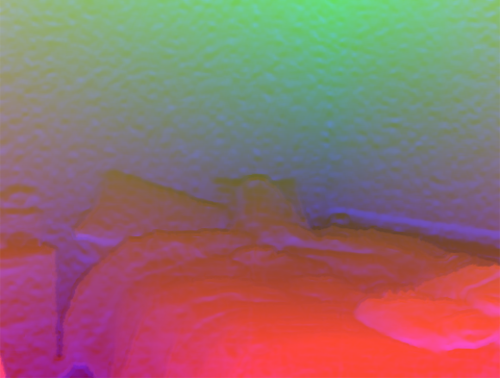
Approach 2
Train neural network on RGB image as well as separately on HHA format of the depth image
Depth Image
HHA Image

Slide 7
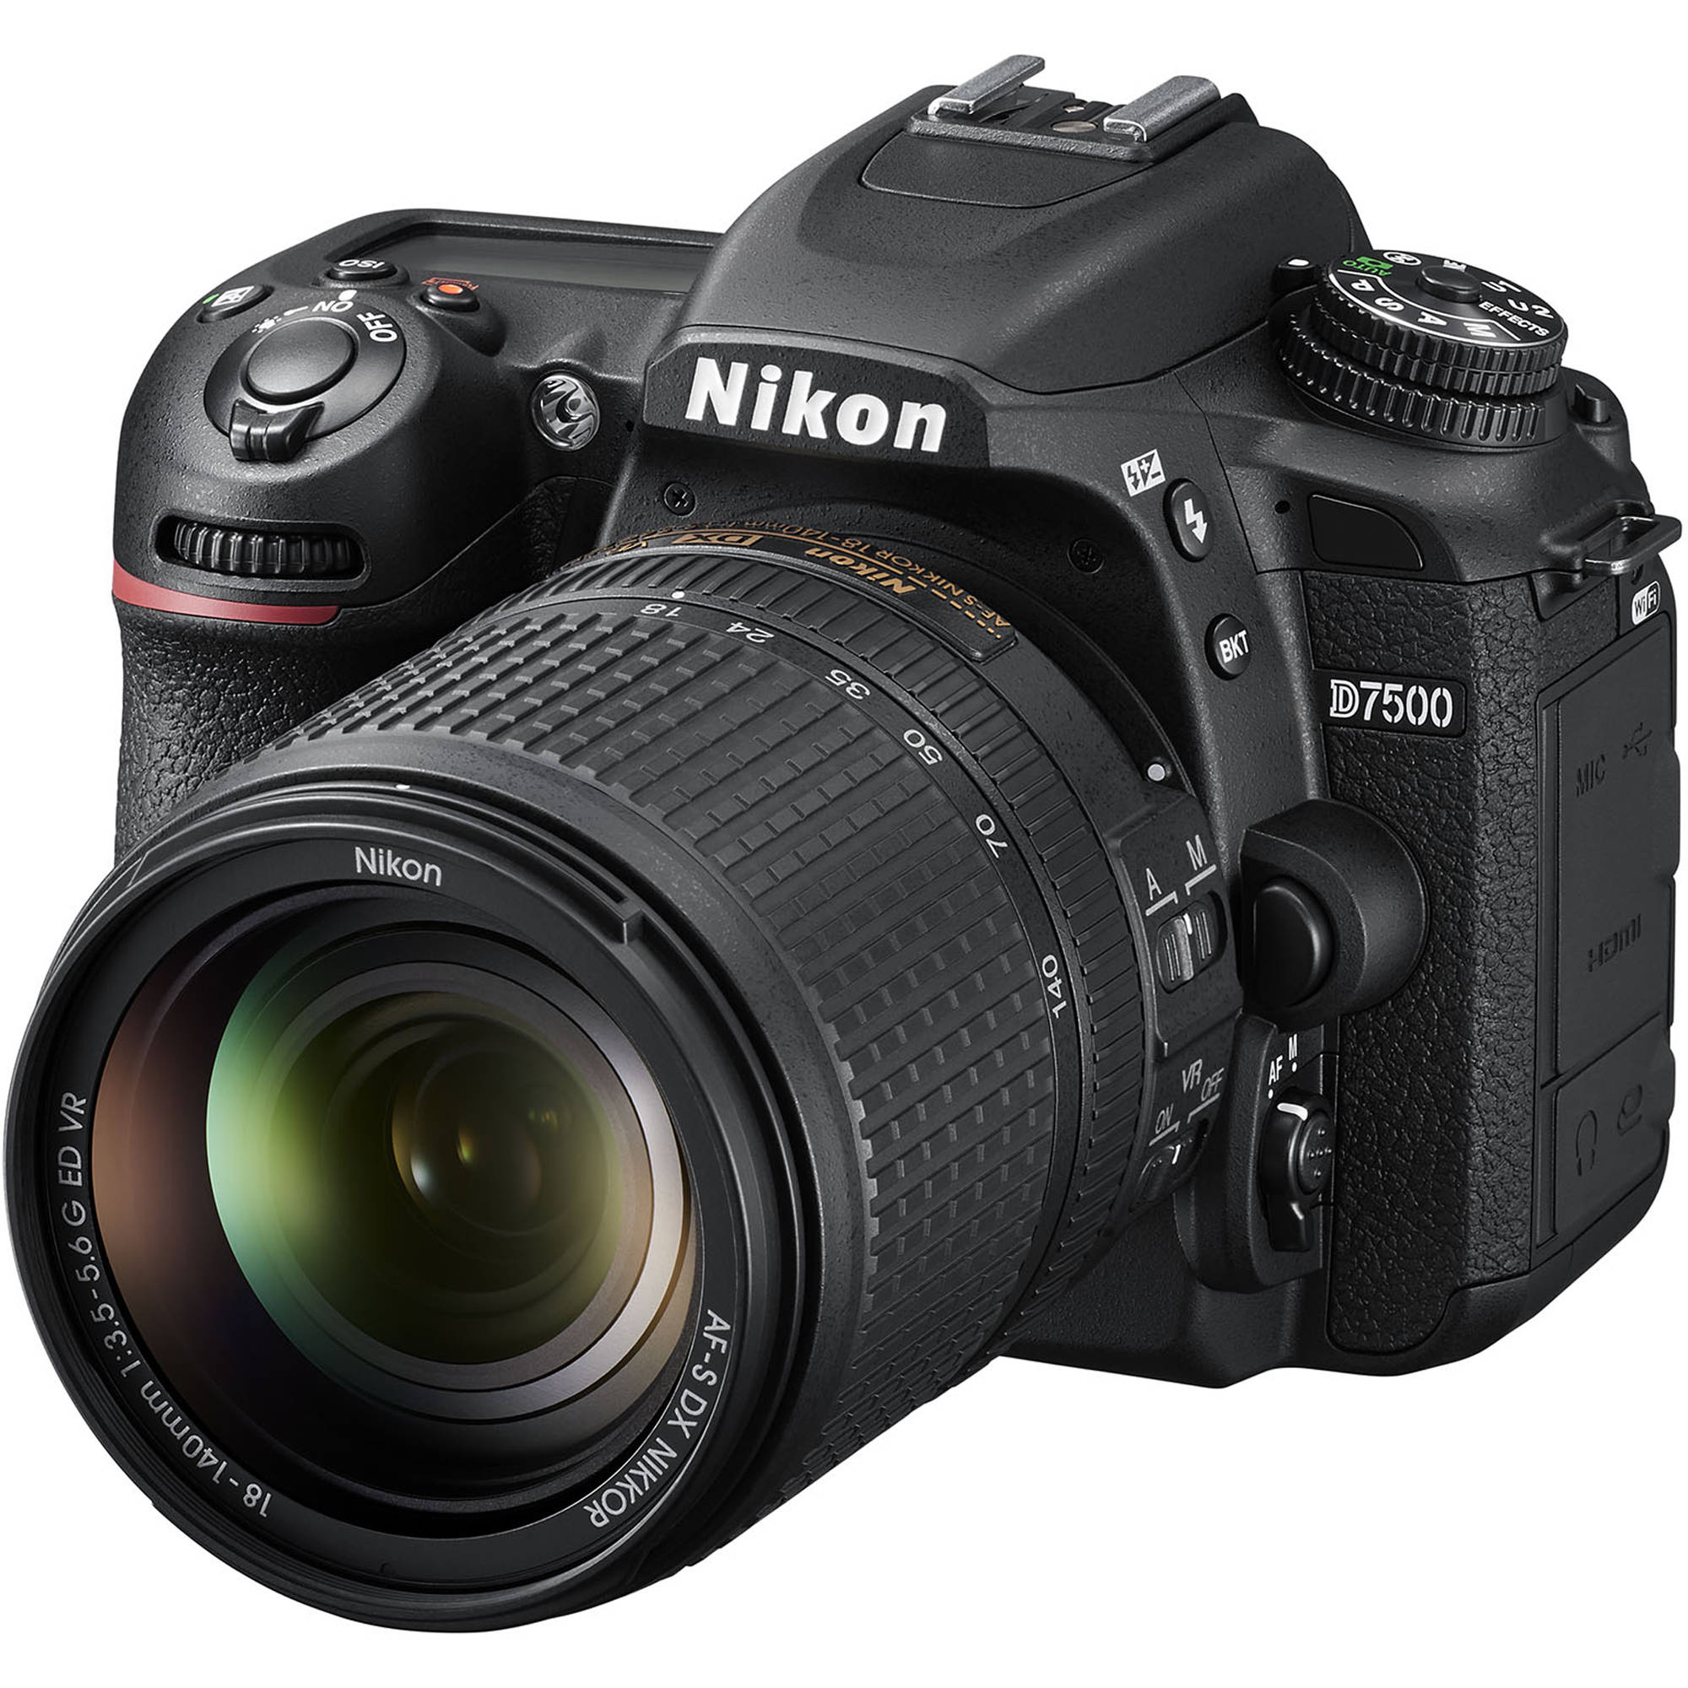
Hackathon Goal
Training our Model on one custom object using RGB and depth images and then detecting it in test images with both the types of data
Selected Object: Camera

Slide 8
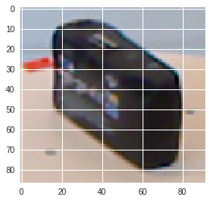
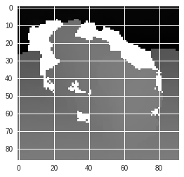
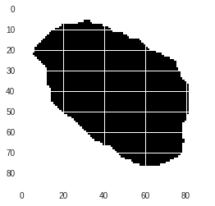
Training Dataset
Open Images Dataset V4 + by Google contaning 600 categories
Microsoft Kinect RGB-D dataset
Sample:

Slide 9
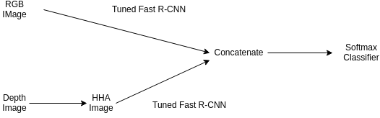
Architecture

Slide 10
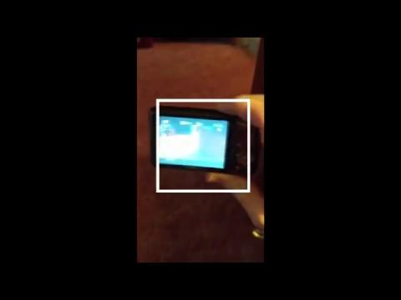
Demonstration

Slide 11
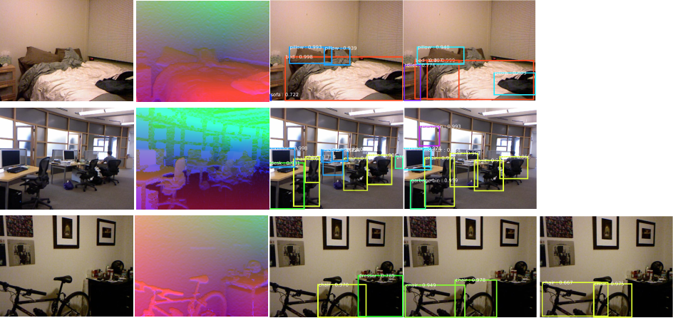
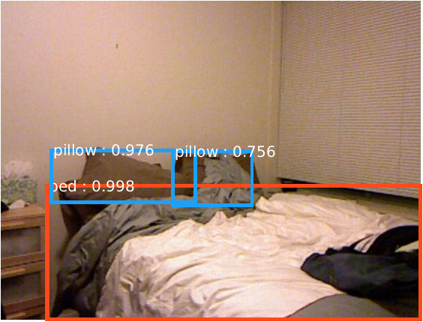
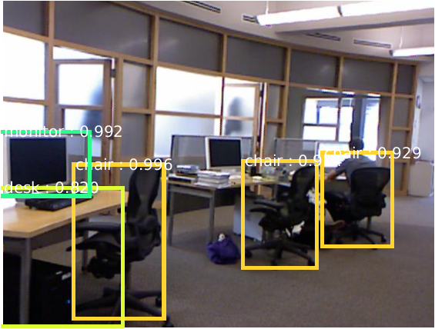
Future Work
Integrating HHA image with the RGB one for better model accuracy
Use of fine-tuned YOLO so that it can be used in real-world live scenarios

Slide 12
Thank You

